Slide 1
Listeria, spp.: An Experience - by David Feld

Slide 2
The name, Listeria, has followed me around for over 30 years.
Like most people, including food microbiologists, Listeria was a genus of bacteria which I had not come across much, except as a taxonomic oddity. It was listed as a mysterious, Gram-positive rod of no apparent affiliation.
In 1987, we all became aware of outbreaks of food-poisoning and abortions – eventually found to be caused by Listeria monocytogenes, an organism which is found in many natural environments.

Slide 3
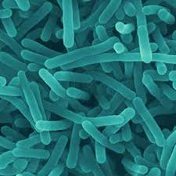
Electron micrograph of Listeria monocytogenes

Slide 4
There were originally thought to be five species, L. monocytogenes, L. innocua, L. ivanovii, L. seeligeri and L. grayi plus its subspecies L. grayi murrayi, of which only the first two are definitively pathogenic to humans.
The last two were once placed by some in the genus Murraya. Another ‘species’, ‘L. denitrificans’, is now classified in the genus Jonesia, family Micrococcaceae.
(Genetically, Listeria has been found to be a polyphyletic genus – and recent research has suggested the erection of two new genera, Mesolisteria and Paenilisteria.)

Slide 5
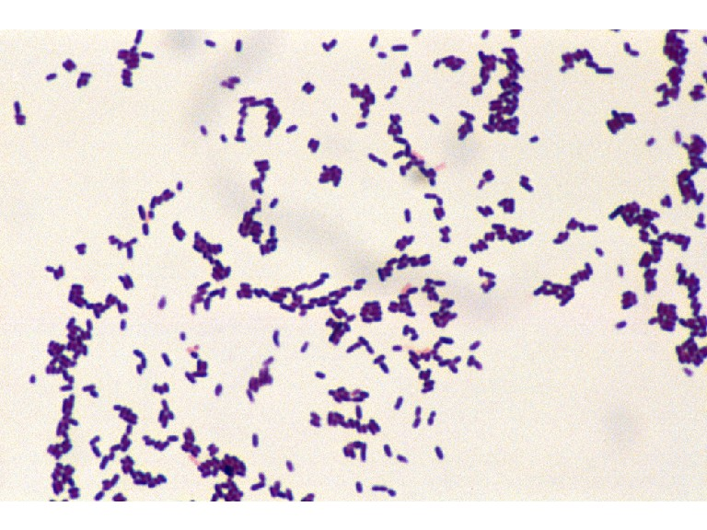
In the time since then, we have found that there are now twenty species! They occupy their own family, Listeriaceae, within the order Bacillales and the division Firmicutes. They are typical Gram-positive, non-sporogenous, flagellate rods, which are facultatively anaerobic and catalase-positive. They are easily killed by temperatures of 70°C and above.

Slide 6
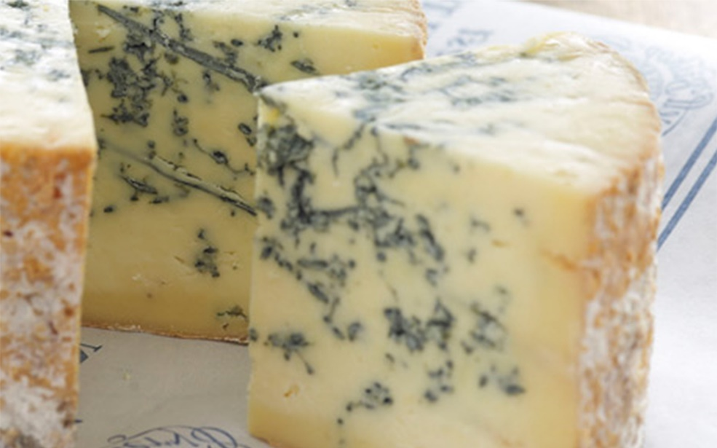
In the late 1980s, I was heading the Microbiology Laboratory at Christian Salvesen Central Laboratory. We were trying to extend our customer base, and had made contact with a local Stilton creamery which was worried about Listeria in their factory and products, and the price which they were paying an external laboratory – and we took on their business, including food-testing and H&H audits of their premises.

Slide 7
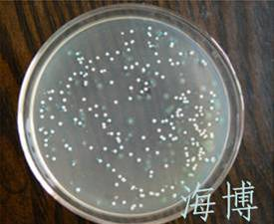
At that time, there was no specific medium for analysing food and other samples for Listeria, spp. The only medium being used was McBride’s Agar. We used this as a plating-medium, but Listeria colonies could only be identified using a light-source set at 45°. In this light, typical colonies would show a ‘cut-glass’ appearance.

Slide 8
After a year or so, LabM introduced their Listeria Selective Agar, or LSA – which was a huge blessing. On LSA, a Listeria colony was depressed like a saucer, dark brown to black and with a dark ring around it (showing aesculin-hydrolysis). We had a very good relationship with LabM for their media and disposables for many years from then!
Never to be outdone by LabM, Oxoid followed suit with their LSA very soon afterwards

Slide 9
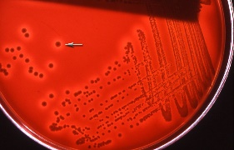
Presumptive-positive colonies could be purified by re-streaking on to a non-selective medium such as Columbia Blood Agar (CBA) which, after incubation, also gave an indication of haemolysis.

Slide 10
A rather better medium, PALCAM, developed by my old friend, Peter van Netten (who also developed ‘Diasalm’ for Salmonella) with David Mossel, came later.
These two gentlemen turned up regularly at conferences on Listeria and listeriosis, together with the late Professor Dorothy Jones of the University of Leicester, who worked with Peter Sneath, the numerical taxonomist, and who was a real character!

Slide 11
At about the same time, bioMérieux extended their API range to include a Listeria identification strip – another blessing! We could now fairly easily put names to presumptive-positive isolates, although the family taxonomy was still in uncertain.
Before API Listeria, we had to carry out a Gram-stain, an in vitro catalase test – and a hanging-drop motility test to show typical tumbling motility. (The last was always gratifying when it worked!)
Positives at this stage would be followed by a serological test, using anti-Listeria antisera.

Slide 12
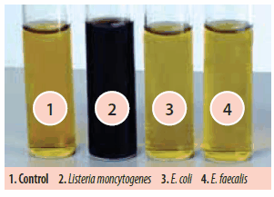
The problem with direct plating on to any dried, agar-based medium is that low-numbers of organisms in a sample (say, less than 10 viable cells mL⁻¹) are not necessarily isolated. Shortly after the appearance of LSA, selective broths became available.
Firstly, Half-Fraser Broth was used, in a 25g:250mL dilution, to encourage – resuscitate – low-viability cells in a brief incubation. An aliquot was then transferred over to an enrichment broth.

Slide 13
Listeria Enrichment Broths (LEBs) contain three Gram-negative- and Staphylococcus-inhibiting antibiotics which enable laboratories to enrich selectively Listeria, spp. in suitably-diluted samples at an appropriate temperature overnight, before plating out on to the dried selective medium, such a LSA or PALCAM.
After incubation, the plates could be read as presumptive-positive 48 hours after initial sample preparation. Using an API strip or similar would add another 18 to 24 hours, if a customer wanted definitive speciation.

Slide 14
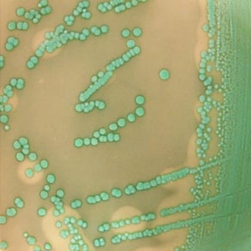
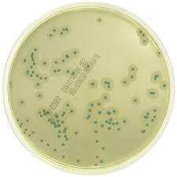
Harlequin Listeria Chromogenic Agar (LabM) | ALOA Selective Chromogenic Listeria Medium (BioMérieux )
Nowadays, laboratories use chromogenic solid media such as LabM’s ‘Harlequin’ Listeria Agar and Oxoid’s ‘Brilliance’ OCLA (Oxoid Chromogenic Listeria Medium). BioMérieux, manufacturers of API strips, produce a similar medium, ‘ALOA’.

Slide 15
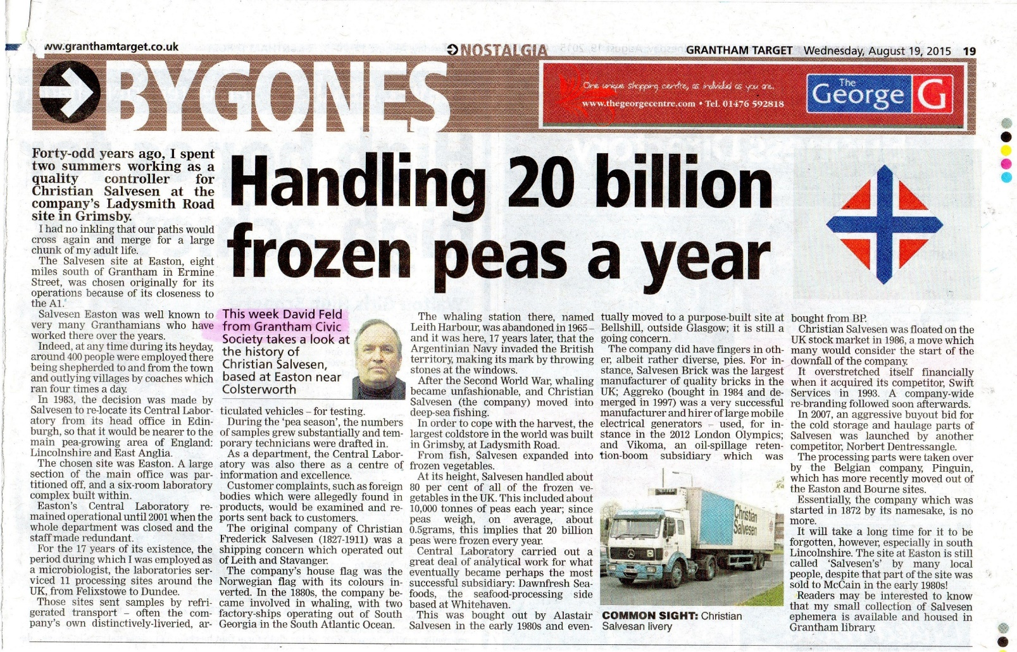
At Christian Salvesen, BM was one of our major suppliers of media (mostly because they made a re-heatable VRBA and undercut other suppliers on PCA!) ‒ and we had just started to use ALOA before our lab closed down.
Listeria continued to follow me around at, and after, Salvesen.

Slide 16
Salvesen itself had a low-level Listeria and Bacillus cereus problem in a cooked-rice production line at the Lowestoft site. Many visits to the site and many profile swabs and samples later, the problem was found to be the post-cooler, chilled-water rice-transfer pipework.
I reasoned that the organisms were surviving in the layer of polysaccharides on the inside of the pipework, which chlorine was not penetrating. Chlorine dioxide, however, DID, and the pathogens went away!
Problem solved (1).

Slide 17
At a well-known chilled meats manufacturer in Norfolk, one of my main responsibilities was to solve their Listeria problem, which was a major concern for customers. Again, many, many early-morning profile swabs and samples later, we found two species – each in a different environment.
One species was being walked into the production area from a contaminated bootwash; the other was on, and especially under, the framework of a mezzanine walkway which overlooked production equipment and which wasn’t being cleaned properly.
Problem solved (2).

Slide 18
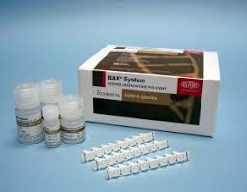
Listeria will continue to be present in the food industry, we will continue to need to use these increasingly sophisticated media in order to be able to detect and remove it. Methods have become so sophisticated, in fact, that polymerase chain reaction technology (PCR) is now being used on a regular basis.
DuPont’s Qualicon BAX® machine is probably the best example.

